Slide 1
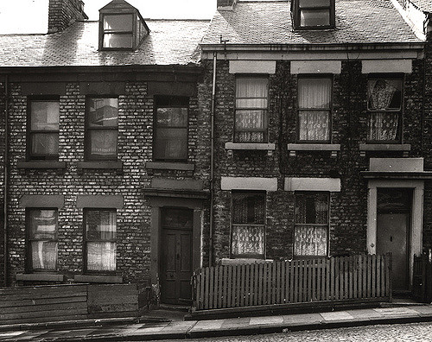
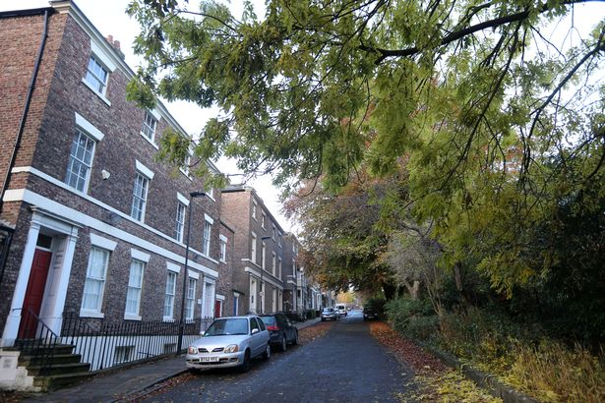
Journey through Summerhill History
----->
The Story of No. 5 Summerhill Grove
Written by Samuel Vincent
Contributors and Researchers - O.L.S.A. History Club

Slide 2
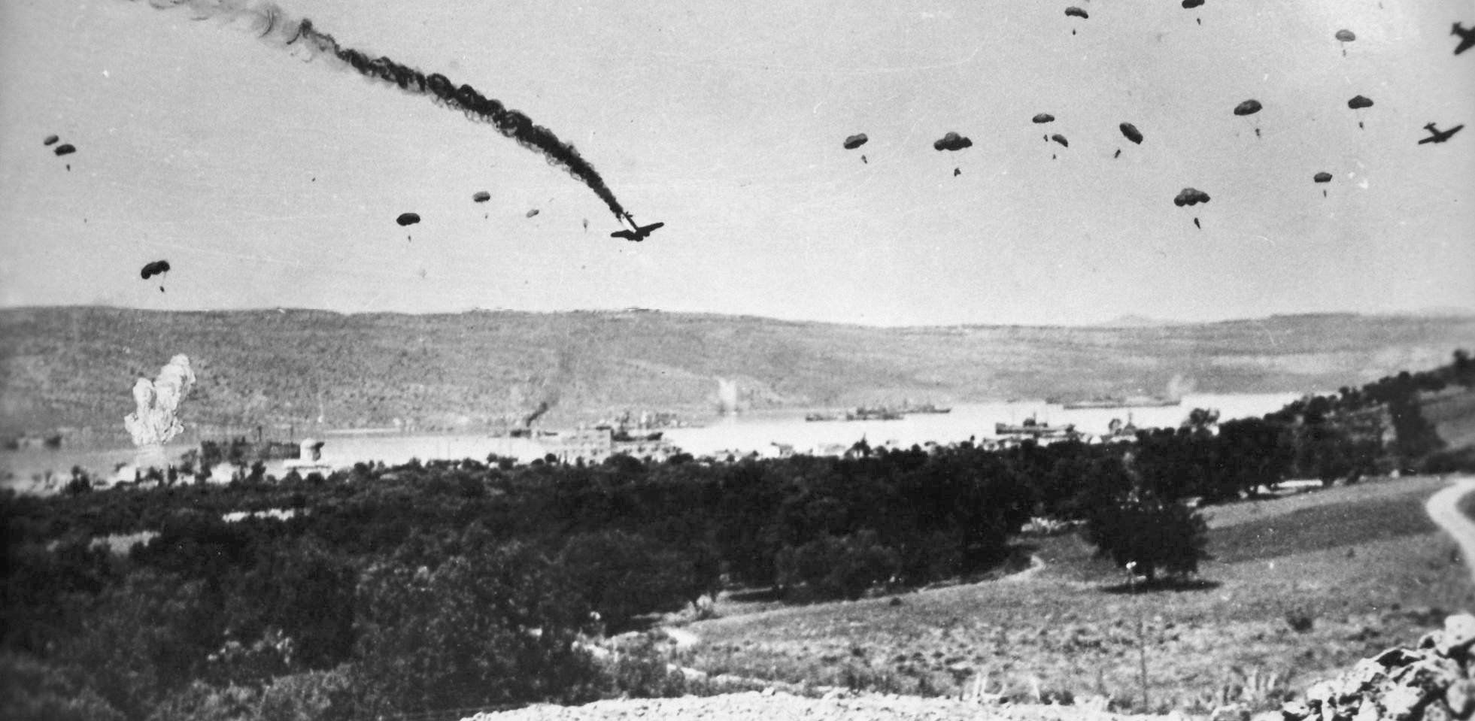
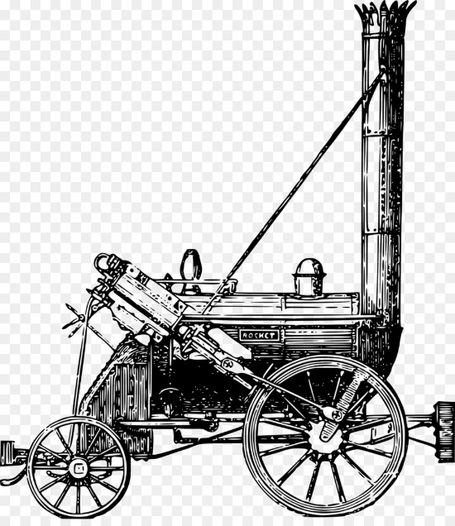
Introduction
In this book, we will explore the history of No.5 and the world starting from 1826 to the present day. Many things happened in such a short period of time, nationally and internationally. Some things you might not have heard of! Read on to find out!

Slide 3
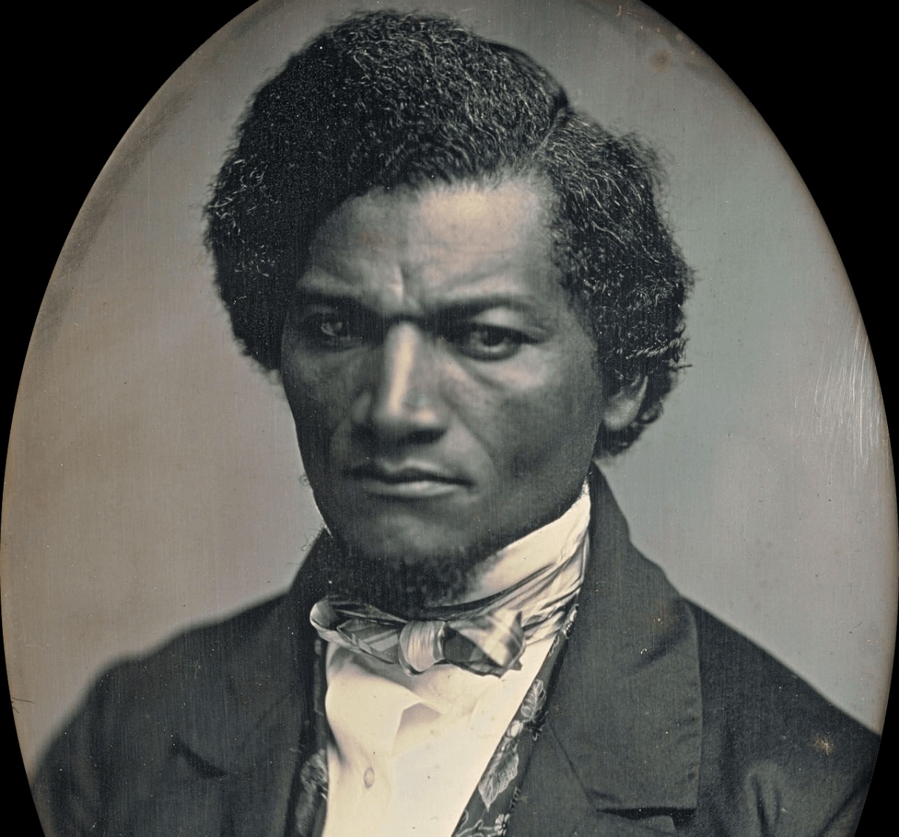
Chapter 1: 1825 to 1855
Frederick Douglass
Frederick Douglass was an African American, who was born a slave in America. His master’s wife taught him how to read the alphabet but he then mostly learnt how to read and write by watching other people. His master was furious because he didn’t want him to be educated - if he learnt how to read and write he could read about how slavery was wrong and free himself from slavery.
Frederick Douglass.

Slide 4
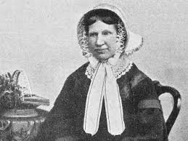
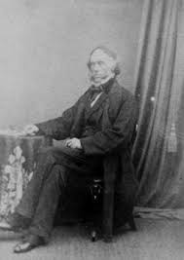
Chapter 1: 1825 to 1855
When he went to stay with the Richardsons in Newcastle, Ellen Richardson, the sister of Henry Richardson went for a walk with Frederick one day. She asked him if he wanted to be free and live back in America and he said yes. This is why Frederick became free because this was discussed and the Richardsons decided to raise money to formally buy his freedom.
Ellen Richardson
Henry Richardson

Slide 5
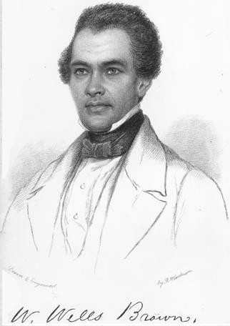
Chapter 1: 1825 to 1855
Who lived in the house first?
No. 5 was bought by the first owner, Henry Richardson in September 1826. During this time both Frederick Douglass and then William Wells Brown, stayed with the Richardsons and money was raised to buy the freedom of them both. William Wells Brown was also born a slave in America.

Slide 6
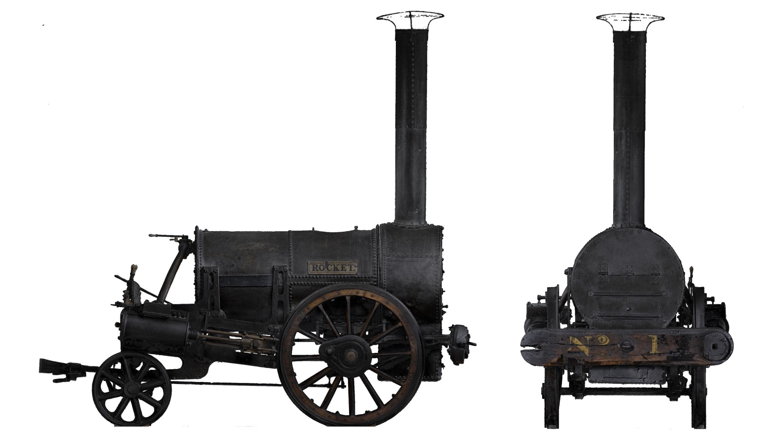
Chapter 1: 1825 to 1855
Fun Facts about the time:
In 1825 the Stockton to Darlington railway was built and it was the first public railway in the world. George Stephenson was in charge of its construction while his son - Robert Stephenson - was making the first trains in the world; building and designing Locomotion and the Rocket in their Engine Works on Forth Banks. This all happened while Robert Stephenson was living in Summerhill Square.
In 1845, William Armstrong invented a machine called the hydraulic crane and it was used all over the world to lift heavy items as well as in shipyards and factories.
The Rocket.

Slide 7
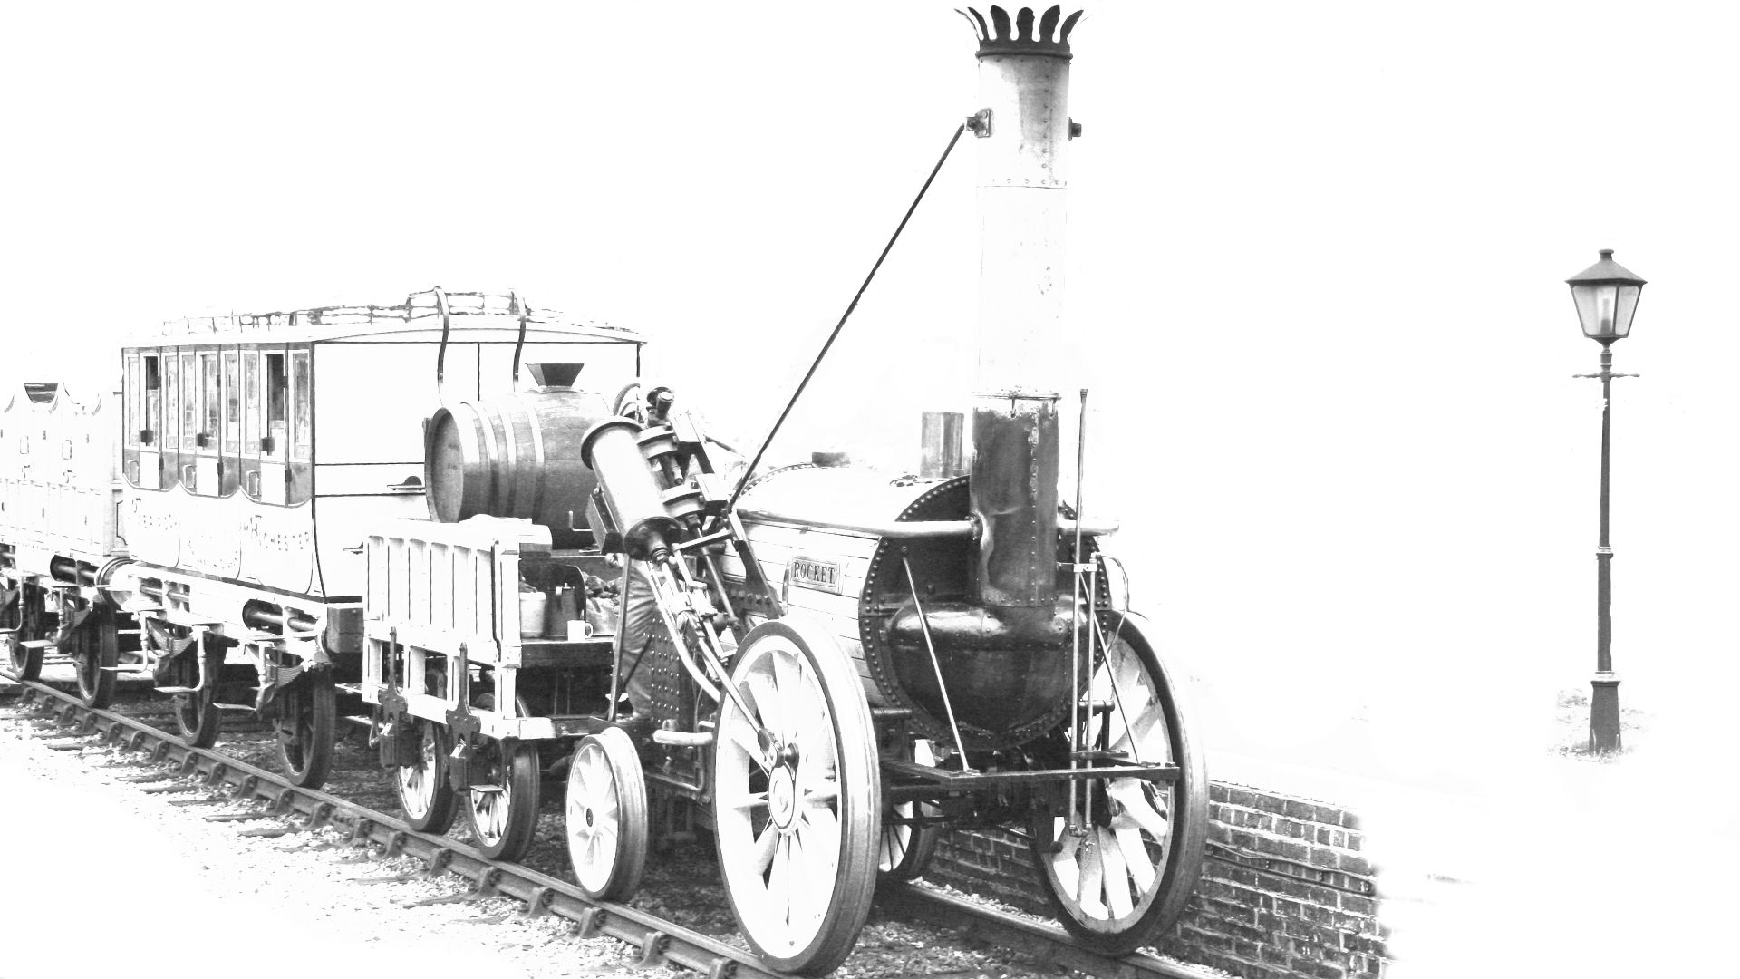
Chapter 1: 1825 to 1855
Fun Facts about the time:
The first intercity railway in the U.K. was the Liverpool to Manchester Railway. It held a competition in 1829 to find the best steam train / locomotive to pull their carriages. Stephenson’s Rocket won this, so it became the first train to pull passengers on coaches on an intercity railway!
The Rocket pulling carriages.

Slide 8
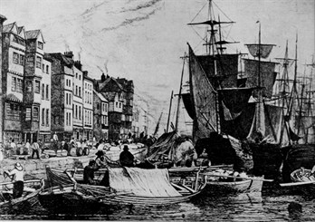
Chapter 2: 1855 to 1901
Henry died in 1883 and his widow-Esther-moved to Jesmond with their four children. Their three sons, Lionel, Henry and Norman all worked as exporters of different goods running their own companies. Norman moved to Bournemouth and is on the 1939 register as a retired shipping manager!
Who lived in the house during this time?
Henry Richardson sold the house in 1857 to Henry Clapham who was a coal merchant from Northamptonshire and his wife Esther, who was from Newcastle. Henry and his family then moved to Holley House in Gateshead - where they had 4 servants in the 1871 census.
After that, they moved to North Ashfield, Elswick where the 1881 census shows that they had 4 children and 5 servants in the house and by this time Henry was a ship-owner and Town Councillor.
Newcastle Quayside in the 19th Century

Slide 9
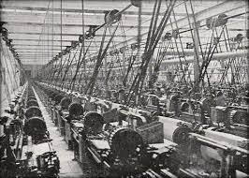
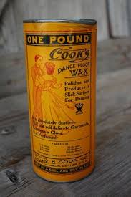
Chapter 2: 1855 to 1901
In 1865, the house was bought by Frederick Clark - an oil refiner and chemical grease manufacturer from Rutland. Grease was used to keep machines working which was very important because of all the factories in Victorian times. Frederick Clark lived at No. 5 with his wife (Phoebe) and their 3 children until 1883 - when he moved to Westmorland Road. Sometime between 1881 and 1891, his wife Phoebe died as he was a widower by 1891 census.
Machines needed grease to keep them working properly.

Slide 10
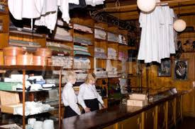
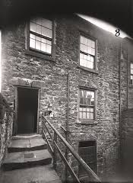
Chapter 2: 1855 to 1901
John became a councillor in 1888 and by the time they moved to 5 Summerhill Grove, he had retired from being a draper. He must have been very successful to retire so young!
In 1883, John Beattie, who came from Cumberland where his father was a farm labourer, bought the house. When he was 16 years old and living on Blenheim Street, he was an apprentice draper in 1861.
By 1871, he was the householder at that same address and had married his wife Sarah and they had 3 children. In 1881, they were living on Westmorland Terrace and had 6 children although their youngest-Harold-died in 1887, aged 6.
A draper’s shop
Blenheim Street

Slide 11
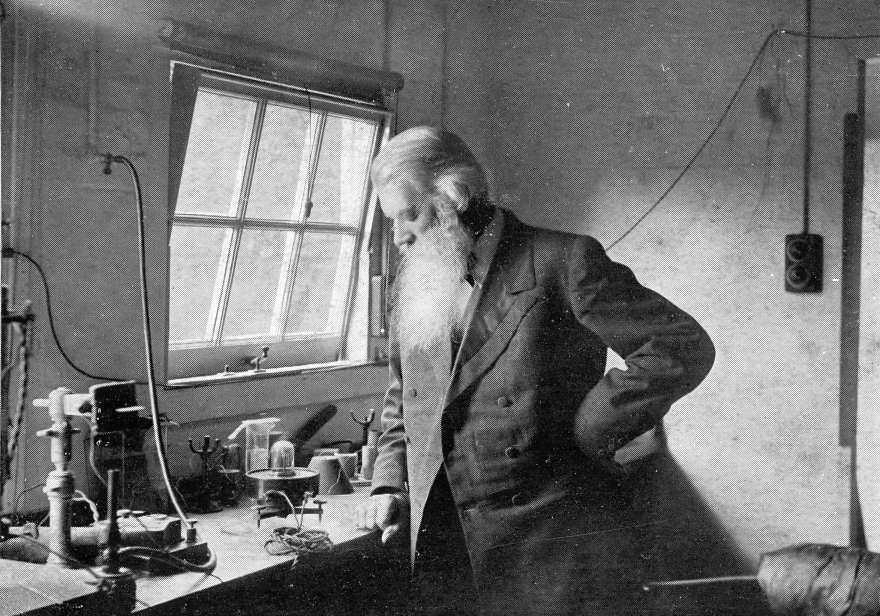
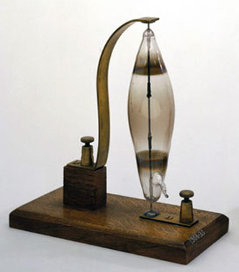
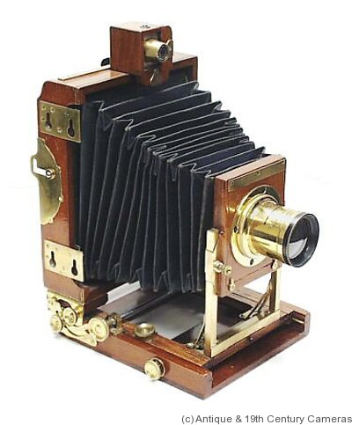
Chapter 2: 1855 to 1901
Fun facts about the time:
In 1863, Armstrong developed hydroelectricity to power his mansion, Cragside.
In 1871, Joseph Swan invented a way of taking photographs (called Dry Plate Photography) and that was how photography became so popular!
In 1878, Joseph demonstrated his new electric lamps in Newcastle. His home was the first house in the world to be lit by electric light. In 1880, the whole of Mosley street was lit by electric lights and Cragside, Lord Armstrong’s mansion, was lit by electric light in November 1880.
In 1884, John Holmes invented the light switch in Newcastle when he was installing electric lighting in his father’s house.
Joseph Swan inventing the light bulb.
Joseph Swan’s early light bulb.
This is a camera from 1871.

Slide 12
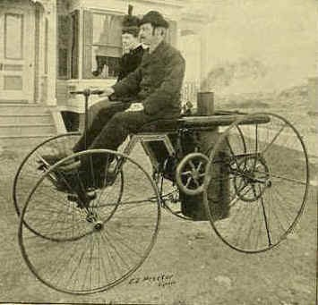
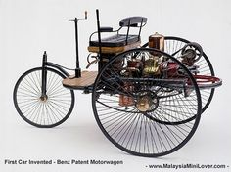
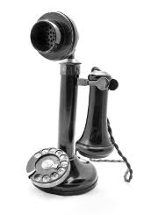
Chapter 2: 1855 to 1901
Fun facts about the time:
In 1886 the invention of the first universally recognised car was made by Karl Benz (Benz Patent Motorwagon). Lots of other people in different places were trying to do the same thing, but Karl got there first.
In 1876, Alexander Graham Bell invented the first successful telephone – and he took out a patent so nobody could steal his idea!
An early steam car.
Benz Motorwagon!
An early telephone!

Slide 13
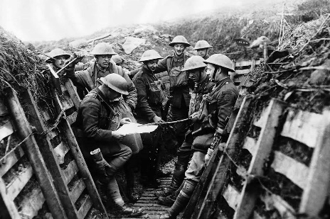
Chapter 3: 1901 to 1918
World War I
In the year 1901 Queen Victoria died and her son Edward became King Edward VII. 13 years later World War 1 began in August 1914.
Friends and Foes
During WW1, we were allies with France, Russia, Italy and the United States of America. Our foes were Germany, Austria, Hungary, Ottoman Empire and Bulgaria.
Men in the trenches.

Slide 14
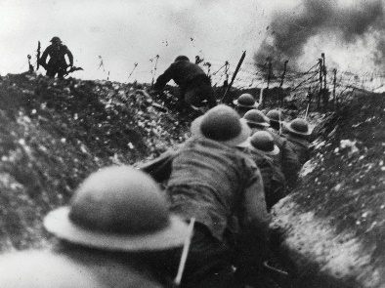
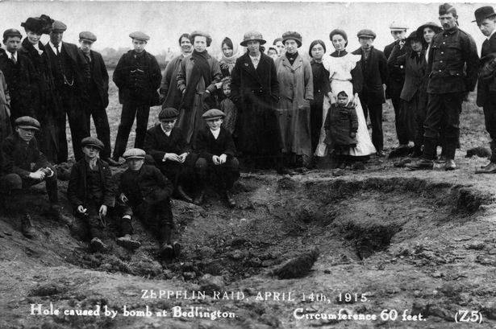
Chapter 3: 1901 to 1918
Life And Death
Six million people in the British army served in the war and seven hundred thousand died. In 1921, poppies were used to raise money for the soldiers, family and the injured - just like when the Richardsons helped Fredrick Douglass buy his freedom in 1846.
The End
On the 11 November, 1918 we signed the peace treaty with our foes and ended this terrible war. The sad thing was that soldiers who had been injured were still dying from their wounds months after the war ended.
Men in the trenches.

Slide 15
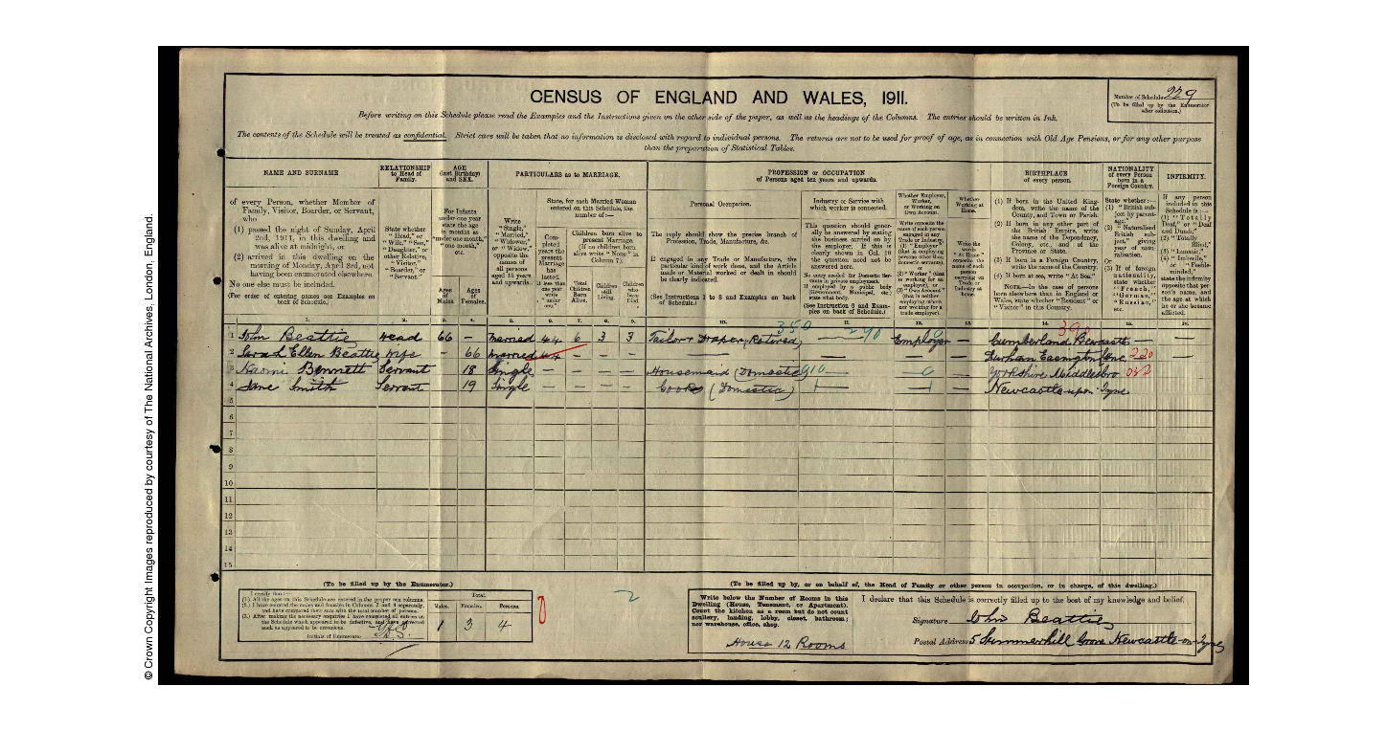
Chapter 3: 1901 to 1918
Who lived in the house during this time?
John Beattie and his family were still living in the house up to 1911. He was a councillor and a J.P. - which means Justice of the Peace (a judge).
In 1915, John Beattie, who would have been seventy years old sold the contents of the house - possibly because his wife died and he was moving somewhere smaller.

Slide 16
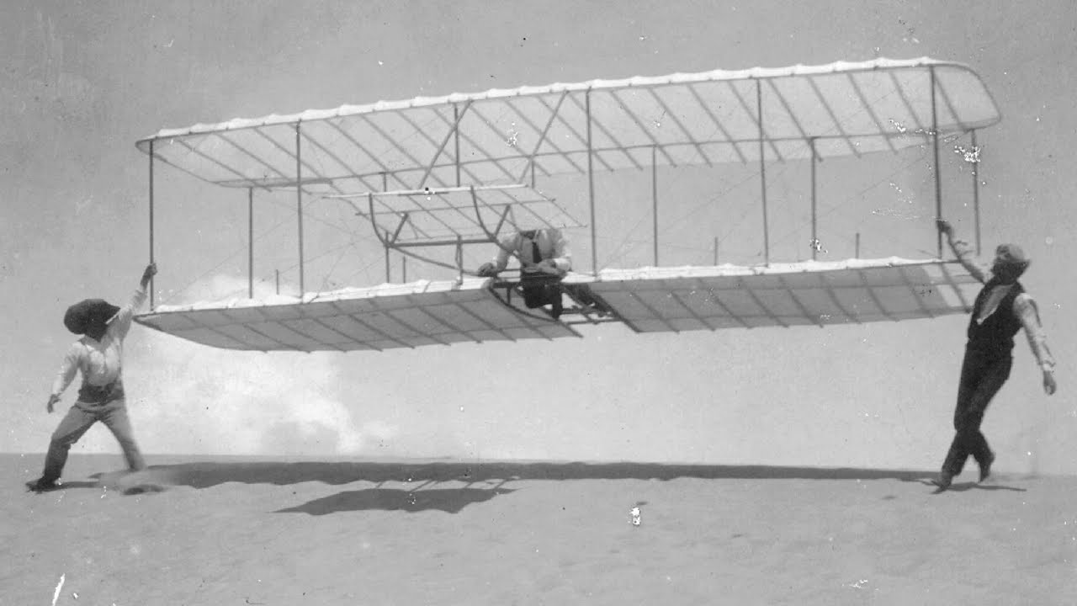
Chapter 3: 1901 to 1918
After the war, the rules about voting in elections changed. Before the war, only some men could vote. After the war, all men over 21 and women over 30 could vote. This was because they had served their country by fighting and helping. It seemed unfair that even when they did that, they still didn't have a say in who ran the country.
Fun facts about the time:
In 1908, Gladstone Adams came up with the idea for windscreen wipers as he was driving home from a Newcastle United football game in a car, in the rain.
In 1903, the Wright brothers invented the first plane after thousands of note taking and tests. They worked in America at a bike shop.
In February 1913, the Robert Sinclair Tobacco company in Newcastle became the first company in the U.K. to make deliveries by plane. Their planes took off from Gosforth Park and flew to different places in the North East.
Wright Brothers’ plane.

Slide 17
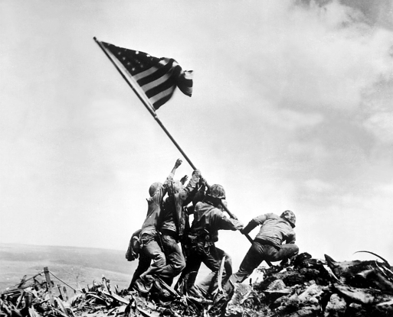
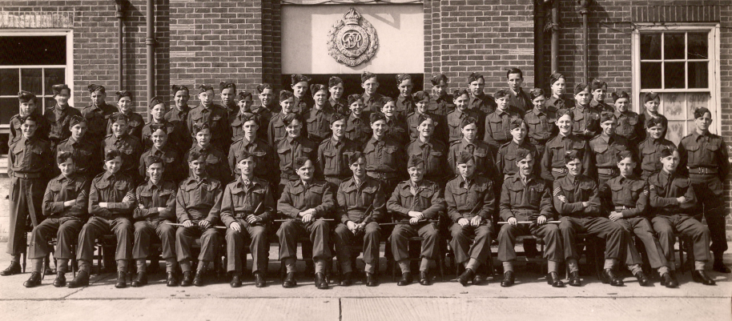
Chapter 4: 1918 to 1945
America joining the war.
World War 2
After the First World War ended in 1918, everyone hoped that there would finally be peace – for all time. Unfortunately, this didn’t happen. On the 1st of September 1939, the beginning of World War 2 was announced by the Prime Minister, Neville Chamberlain. It was a brutal war and an estimated 70 – 85 million people died (which was about 3% of the world’s population). World War Two in Europe ended on May 8th 1945.
Soldiers.

Slide 18
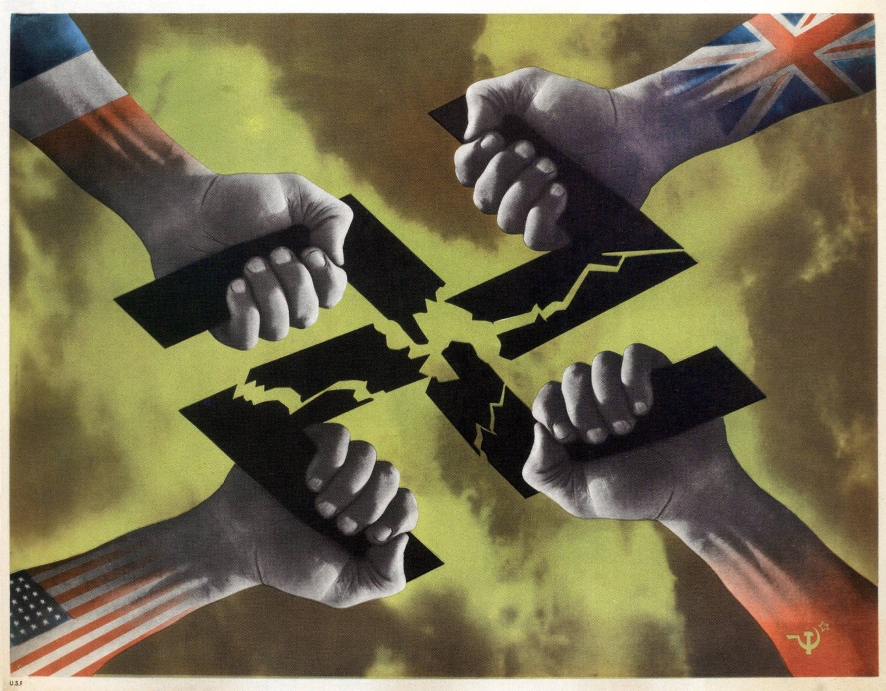
Chapter 4: 1918 to 1945
The raids killed 43,000 people and lasted for eight months, petering out when Hitler began to focus on his plans for his invasion on Russia in May, 1941.
WW2
Japan's invasion of Manchuria caused them to pull out of the League of Nations. This would pit Japan against the Allies in World War II, in turn leading to the United States joining the war in the Pacific and Europe after Japan attacked the Unites States naval base at Pearl Harbour.
Britain
France
The Blitz
The Blitz started on September, 1940 and ended on May, 1941. The Blitz is a bombing by enemy planes that destroyed half of London! It was a devastating experience for those who witnessed it and some are still alive today!
Nazis
America
Russia

Slide 19
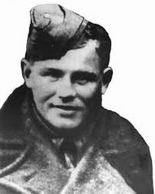
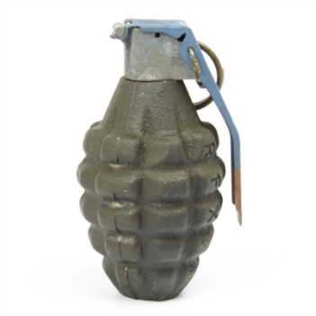
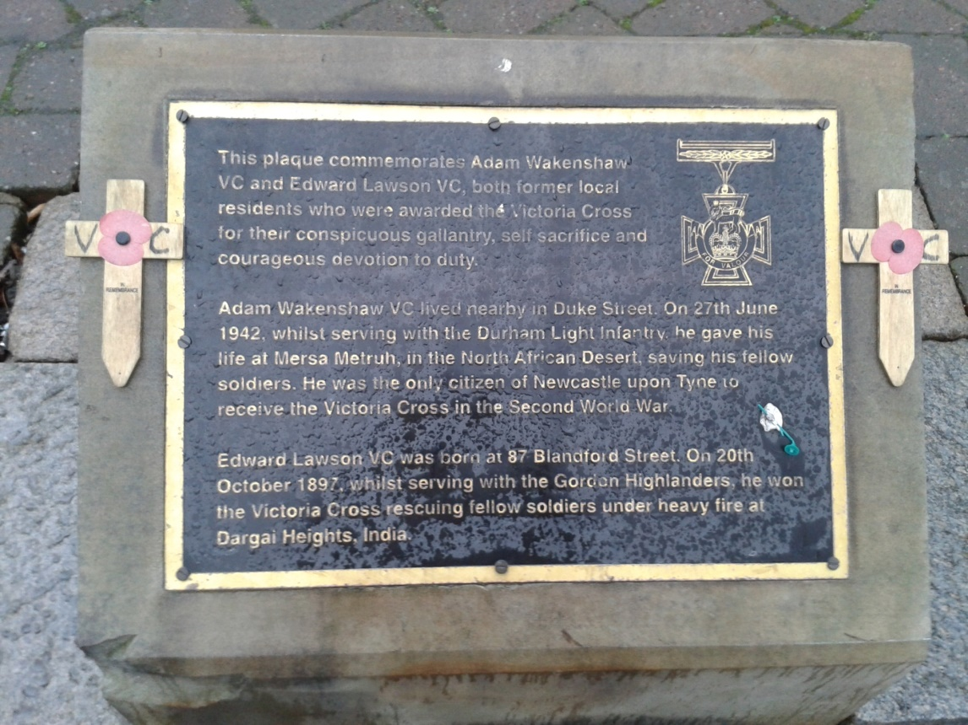
Chapter 4: 1918 to 1945
Adam Wakenshaw
Adam Wakenshaw was a soldier during WW2 and he received the Victoria Cross. He got it when he was with a group of fighters who were protecting a city of innocent people. When his side retreated because of a grenade thrown by the enemy, Adam, who was using a big gun, didn’t retreat. A second grenade was thrown by the enemy which blew off the lower part of his legs, but he didn’t stop firing for another fifteen minutes.
A third grenade was thrown and blew off his arm, but he still did not stop firing for another fifteen minutes. He died of blood loss, yet he destroyed twenty tanks in the process, saving a city full of innocent people!
Grenade from WW2
Adam Wakenshaw

Slide 20
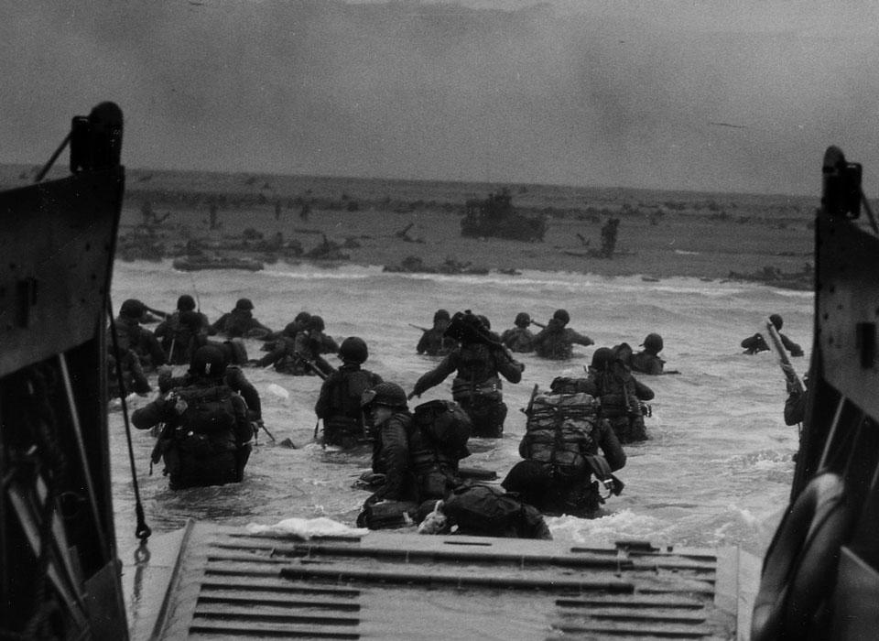
Chapter 4: 1918 to 1945
England and America attacked five beaches, Utah, Omaha, Gold, Juno and Sword beach.
It was the most brutal part of a battle the world has ever known. Just imagine sailing on a boat towards a beach that you could die on. People were being sick - knowing death was coming!
D-Day
D-Day took place on Tuesday 6 June 1944 and was the largest seaborne attack on enemy coasts in history. It was the first day of the Allied Forces triumph in winning the war. It took place on different Normandy beaches in France at the same time so that the Allies would be within striking distance of the port city of Cherbourg. D-Day’s secret name was Neptune. During the war everything was coded so our enemies wouldn’t understand what we were planning.
Men attacking
the Normandy beaches.

Slide 21
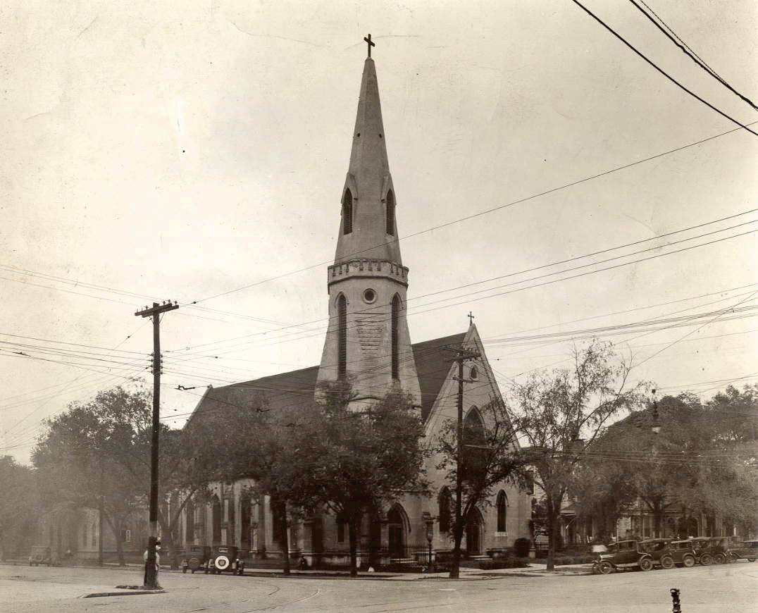
Chapter 4: 1918 to 1945
Who lived in the house during this time?
The house was sold to St. John’s Parish in 1922 - after John Beattie had died (probate of J. Beattie shown on Land Registry).
In the 1939 register, it shows that the house was lived in by 3 priests from St. John’s Parish: William S. Baker; Peter S. Rowell; Edward H. Whitehorn and their housekeeper-Kate Footer and her brother Harry (an unemployed wagonway man). John Beattie’s eldest son-Thomas-became a doctor and was still working as a consultant doctor in 1939 although he was 70 by then.
St. John’s Parish

Slide 22
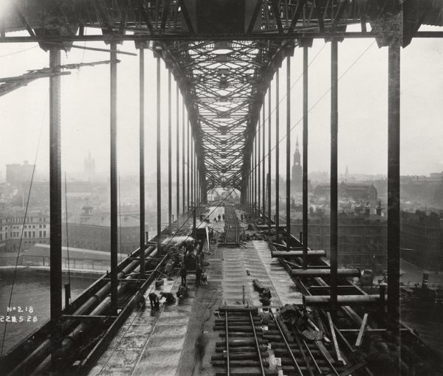
Chapter 4: 1918 to 1945
Fun facts about the time:
In 1920, Lucozade was invented by William Owen, a Newcastle chemist who was trying to create something to help people recover from illnesses.
In 1928, the Tyne Bridge was built and is still standing and in good condition today.
In 1929, Domestos (a type of bleach) was invented by Wildred Handley and was originally sold by door to door salesmen who refilled customers’ stone jars.
In Autumn 1929, worldwide economic problems began and the Great Depression started. That led to the unrest in Germany and enabled Hitler to come to power in 1933.

Slide 23
Chapter 4: 1918 to 1945
In 1929, a trade fair showing different goods, the North East Coast exhibition - ran from May to October and had over four million visitors!
In 1931 at the ICI factory in Stockton, Perspex - shatter resistant plastic – was invented! It was used during WW2 for plane windscreens, periscopes and much more as an alternative for glass. It is still widely used today.
In 1926, the first electronic televisions were built by John Logie Baird. He began broadcasting programmes through the BBC in 1929 to the people who had bought his ‘televisors’ (what they were called back then). Not many people had these though.

Slide 24
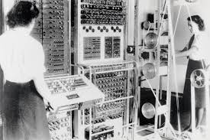
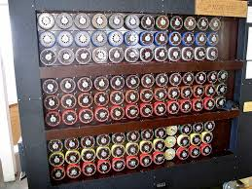
Chapter 4: 1918 to 1945
Before, and during WW2, different machines were built as a part of the effort to understand German codes. These then led to modern computers today. Alan Turing’s machine was made in 1936 and Colossus which was invented in 1943. These two machines could fill one room and were supposed to be a million times faster than the human brain. It was made in a secret base in Bletchley Park. No one knew where it was; not even most people in England itself. You weren’t able to speak about it through your whole life if you had worked there.
Colossus
Alan Turing’s machine

Slide 25
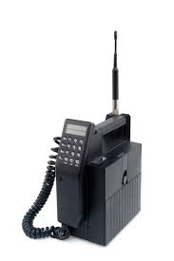
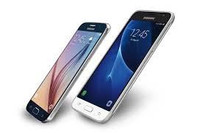
Chapter 5: 1945 to Now
Cars and TV
Cars were very different from now. Long ago, before 1945, people only had two channels on their televisions, but now we have Netflix. If you wanted to watch other channels you had to go to the cinema. Many people wanted to buy cars. Cars were much more popular then.
Can you see the difference between now and then? Social media is more widely available now than it was in the early 90s . Computers are used widely for homework and research, yet in 1945, computers weren’t used as much.
Phones and computers
Phones were very different because now we have mobiles.

Slide 26
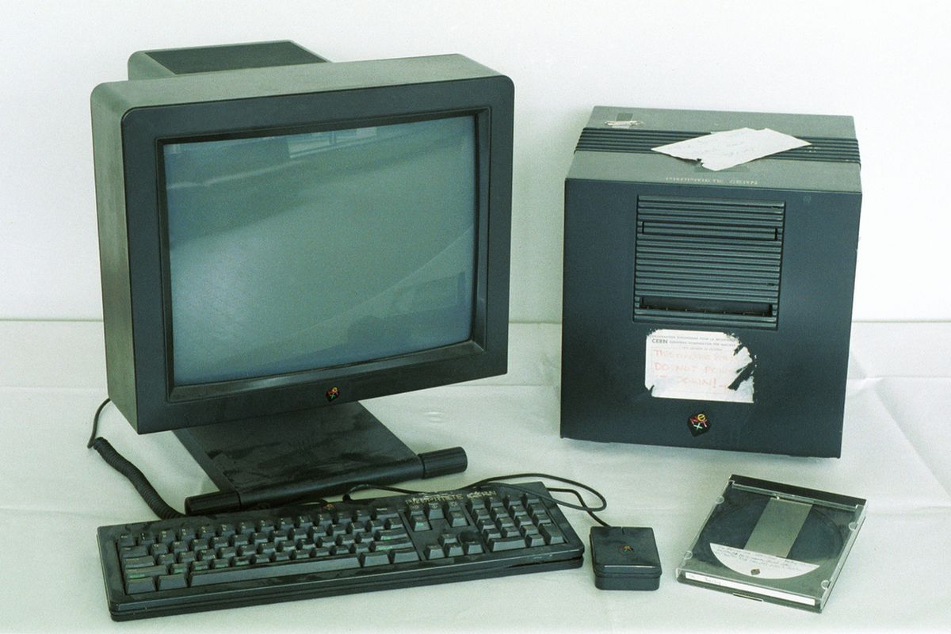
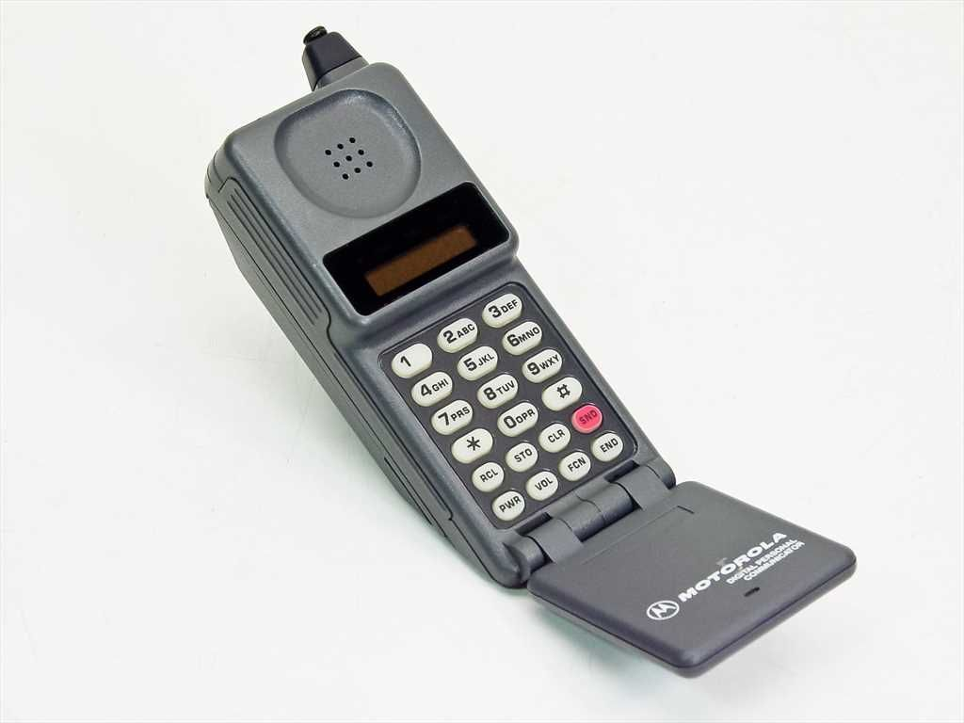
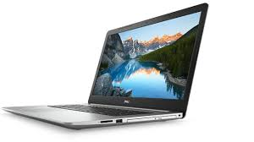
Chapter 5: 1945 to Now
The first desktop computer was made in 1965 and the first laptop was invented in 1975 by the IBM, the size of a small suitcase.
The first smartphone was released in 1994.
The Word Wide Web = the internet, began in 1990 started by Tim Berners-Lee, Professor of computer science.

Slide 27
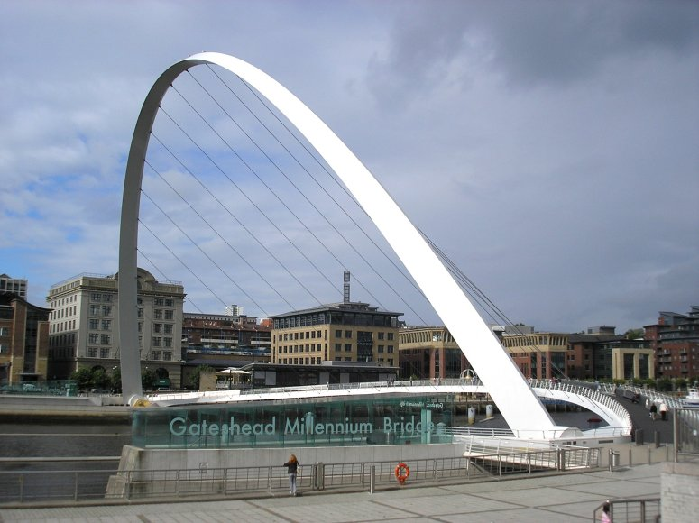
Chapter 5: 1945 to Now
Fun facts about the time:
Gateshead Millennium Bridge was the first tilting bridge to work in the world.
In 1988, the Angel of the North was a huge tourist attraction.
Televisions began to be produced and bought in large numbers, especially in time for the coronation (a ceremony when the King or Queen is crowned). The coronation of Elizabeth II was the first to be shown on live television, with cameras inside Westminster Abbey.
Also the first moon landing took place on July 20th 1969.

Slide 28
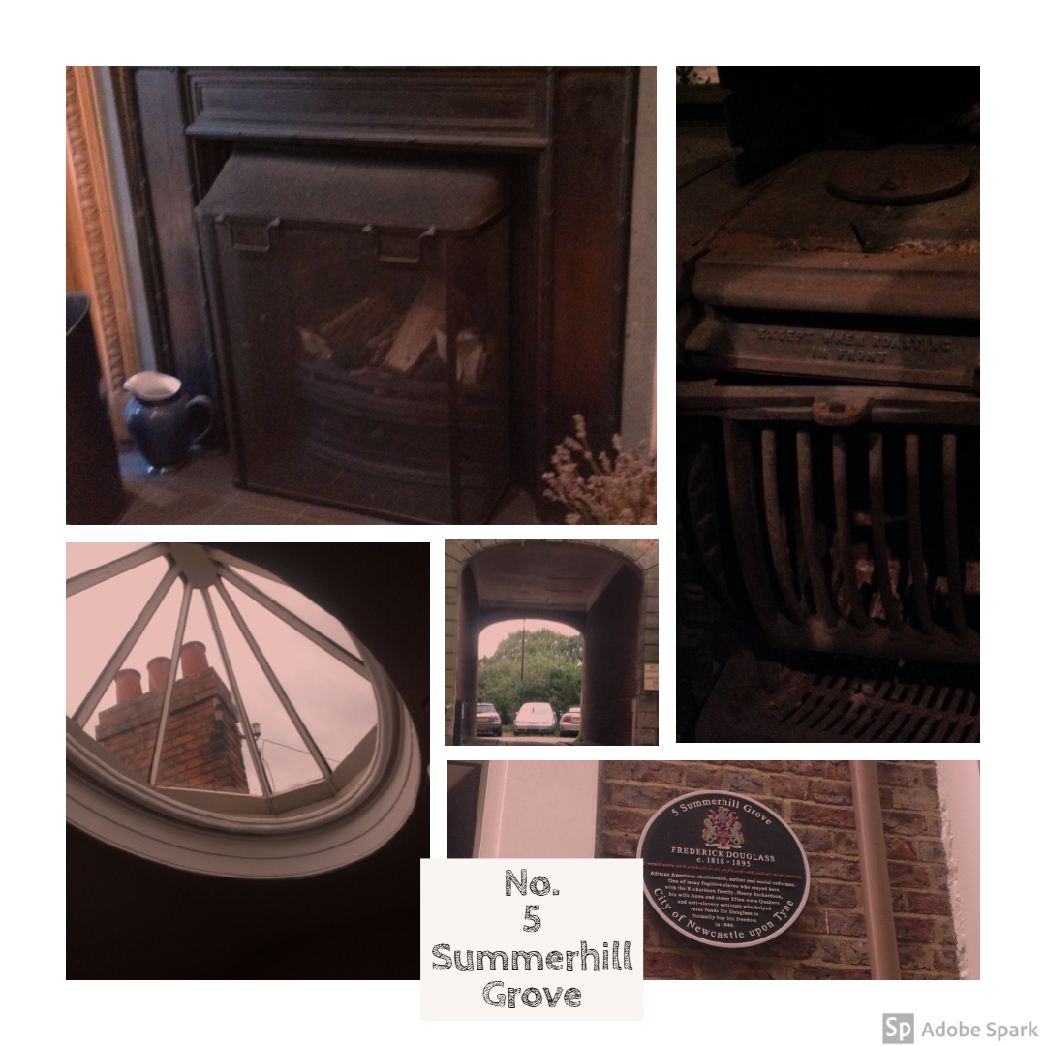
Who lives in the house now?
The house was owned by St. John’s parish from 1922 until 1992 when it was bought by a Mr. Ashdown and then eventually it was bought by Dr. Peel in 2001 – and he still lives there today!
Dr. Peel kindly invited History Club into the house and we saw the original kitchen range (cooker) from when the house was first built! We also looked in the attics where the servants would have lived and tried to imagine what it was like then!

Slide 29
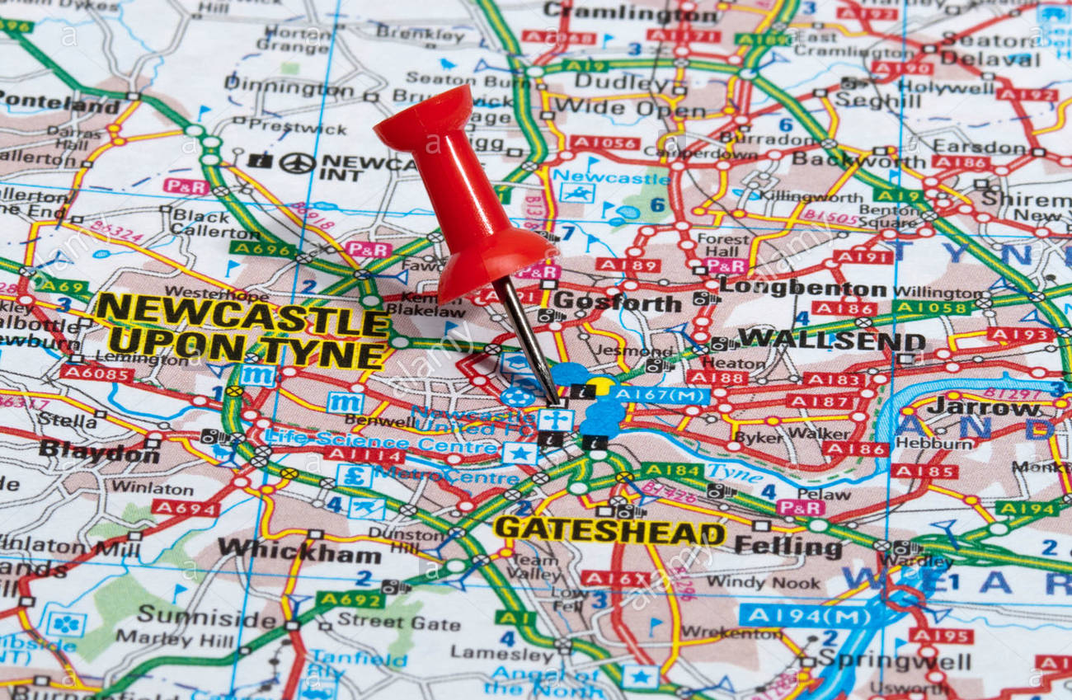
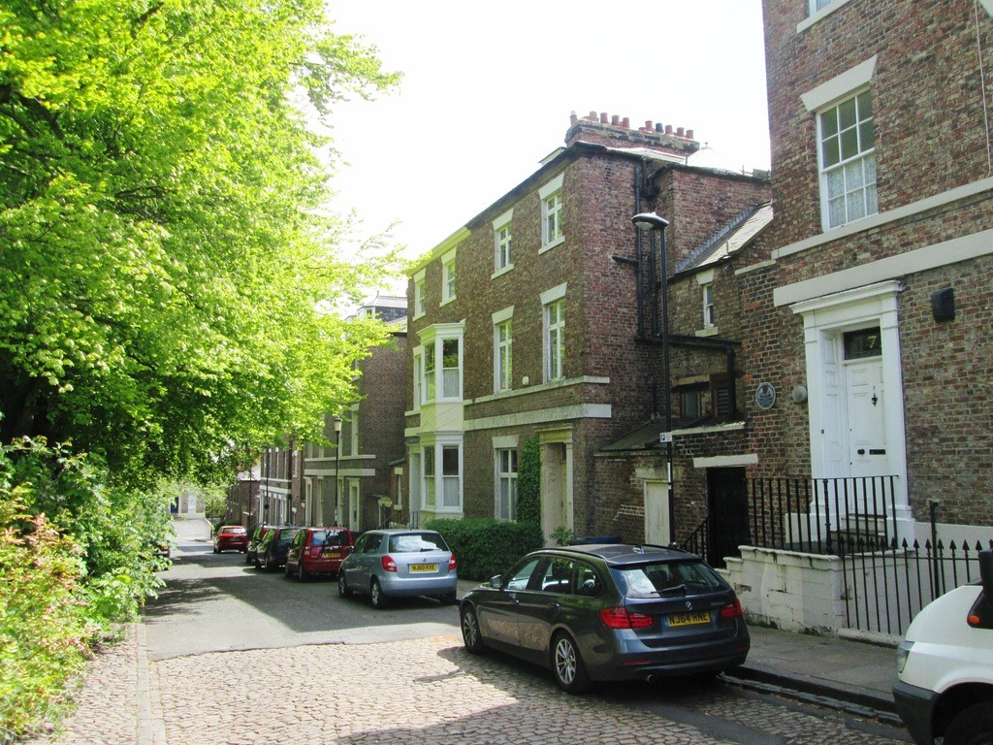
Conclusion
Newcastle is full of surprises, as you know. You just don’t know what could happen and where. Isn’t it epic that the first train ever was built in Newcastle? Two world wars happened and lots of everyday things from our lives have been invented since No. 5 was built. What do you think is cool?

